Slide 1
Module 37: Understanding Siebel Event Models
Siebel Core Developer and Technology School
Notes:
Time: Lecture: 25-35 minutes; no labs
Intent: To explain events and event handlers for objects in the Siebel application. To name functionality that can be triggered by these events.
Flow: Define object instances. Define events and event handlers. Define pre- and post-operation event handlers. Define functionality that can be triggered by event handlers.
Key Terms:
Object instance
Event
Event handler
Pre-operation event handler
Post-operation event handler
Runtime event
Workflow Process
Personalization
Data validation
Business service
Custom script
Please note: Faculty-specific notes are italicized.

Slide 2

Module Objectives
After completing this module you will be able to:
  Describe Siebel object instances and events
  Explain Siebel Event Handling
  List the processes that can be triggered by events
Why you need to know:
  Understanding the Siebel Event model allows developers to successfully extend the behaviour of the standard Siebel application

Slide 3
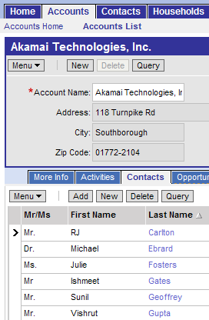
Siebel Object Model: Object Instances
When a user is using the Siebel application, instances of Siebel objects are loaded into memory
View
(Account Detail
Contacts View)
Business Object
(Account)
Applet
(Account Entry
Applet)
Business
Component
(Account)
Applet
(Account Contact
List Applet)
Business
Component
(Contact)
Notes:
The user interface displays instances of UI objects that reference instances of Business Object Layer objects. The Object Manager instantiates and monitors these objects.

Slide 4
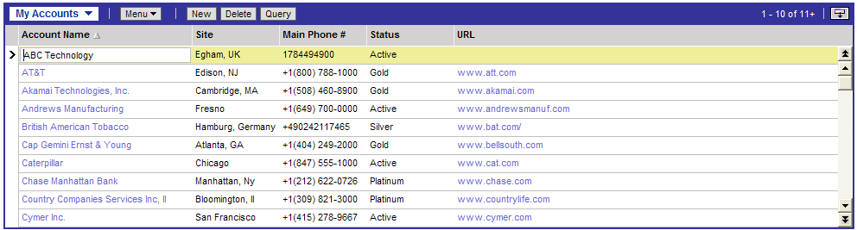
Events and Event Handlers
An event is a user or system action that occurs while the Siebel application is running
An event handler is a process in Siebel that defines how the Siebel application responds to an event
  The event: After creating a new record, the user steps off the record
  The event handler: The Siebel application commits the record to the database
Notes:
Event Examples:
User clicks a button on an applet.
A new activity is inserted by a workflow process step.
User deletes a record.
User logs off the application.

Slide 5
Object Instances and Events
Events occur on the object instances in memory
Example: After creating a new record, the user steps onto next record in the applet
Applet
(Account List Applet)
User steps off Record
Siebel Event Handler tells the business component a new record has been created
ChangeRecord Event fires
Business Component
(Account)
WriteRecord Event fires
Siebel Event Handler causes the record to be written to the database
Record is committed
to the database
Notes:
When a user steps off a record, the event occurs in the applet, which causes the business component ChangeRecord event. The ChangeRecord event handler invokes the WriteRecord method of the business component. The WriteRecord event handler then saves the record to the database.

Slide 6
Event Processing
When a selected event occurs, the Siebel execution engine:
  Fires a pre-operation event
  Executes the standard Siebel built-in event handler
    Not visible or configurable by developers
    Part of the C++ class specified for each Object
  Executes a post-operation event handler process
  Note: Not all exposed events are paired (have pre and post)
“pre” operation
Name prefixed with “pre”
Siebel event handler
Siebel Application
Name not prefixed with “post”
“post” operation

Slide 7
Pre-Operation Processing
Siebel can be configured to perform checks before the standard Siebel event handler is executed and either:
  Continue to the regular Siebel event handler, or
  Cancel the regular Siebel event handler
“pre”
operation
cancel
continue
Siebel Application
Siebel event handler
“post” operation
Notes:
A common example of pre-operation processing is a validation. If the data is valid, allow the record to be saved. If the data is not valid, cancel the operation.

Slide 8
Post-Operation Processing
Siebel can be configured to perform additional processing that occurs after the standard Siebel event handler has been executed
  Processing is not executed if pre-operation cancels
“pre”
operation
cancel
continue
Siebel Application
Siebel event handler
“post” operation
Notes:
A common example of post-operation processing is to create or update data. For example, when an opportunity is created, create an activity to send them a fruit basket.

Slide 9
Siebel Object Types with Exposed Events
Each object type is designed to handle certain processing
  Application
    Events occur at the application level
    Example: Log in to application
  Applet
    Events occur at the applet level
    Example: Drill down on hypertext link or click an applet button
  Business Component
    Events occur at the business component level
    Example: Update or insert a record
Notes:
Events and methods are described in more detail in the Object Interfaces Reference in Siebel Bookshelf.

Slide 10
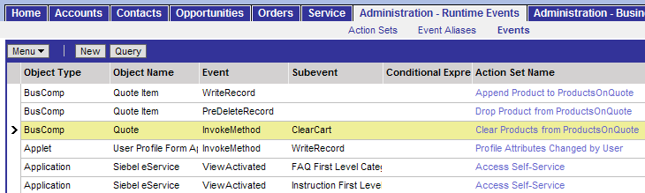
Runtime Events
The Object Manager monitors events occurring in the current Siebel application instance
Select Site Map > Administration – Runtime Events > Events
A runtime event requires no compilation and can trigger:
  Workflow processes
  Personalization
  Data validation
  Business services

Slide 11
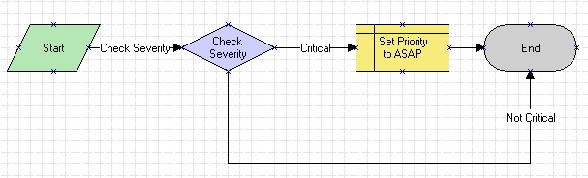
Siebel Workflow Processes
A Workflow process is an ordered set of steps executed in response to a defined set of conditions or an event
  Covered in later modules
Workflow process
Event specified here
Workflow step
Notes:
Workflow processes allow users to define their company’s business processes using a flowchart interface. Users can define a process that includes sub processes, decision points, and tasks. A task can be predefined or custom. Predefined tasks include updates to the Siebel database, notifications (such as an email or page), integration messages to external systems, and calls to invoke server tasks. Custom tasks are defined by the customer using Siebel eScript. Workflow is covered in more detail in an upcoming module.

Slide 12
Personalization
Siebel Personalization helps control content delivery and enforce business rules
  Allows the creation of rules that react to the user’s behaviour at run time
    Example: When an eSales user adds printers to the shopping cart, personalization adds cables and ink cartridges to the Recommended Products lists
  Allows the creation of rules that determine which views, applets, and records a given user will see
    Example: The My Quotes applet will only appear in the home page if the user chooses to add it to their home page layout
Notes:
Personalization functionality consists of:
The Personalization Profile business component, which contains profile attributes for each user
Rules that update the profile attributes for those users
Rules and expressions that determine whether an applet or view should be seen by a user, based on his or her profile attributes
Rules and expressions that build salutations to be displayed in applets, for example: “Welcome back, Pat Penguin. Your performance review is due today.”

Slide 13
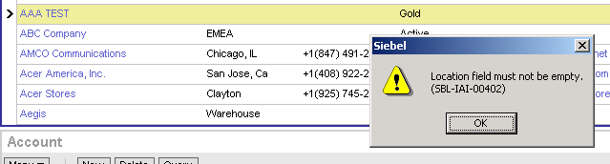
Data Validation
Siebel Data Validation allows field values or records to be validated against business rules
  Enables application administrators to create complex business rules using a declarative interface
  Define messages to be displayed to user if rule is violated
  Validation history can be used to view log of rule violations
Notes:
Data Validation Rules can be created in:
Administration – Data Validation > Rule Sets
The Validation History may be seen in:
Administration – Data Validation > Validation History

Slide 14
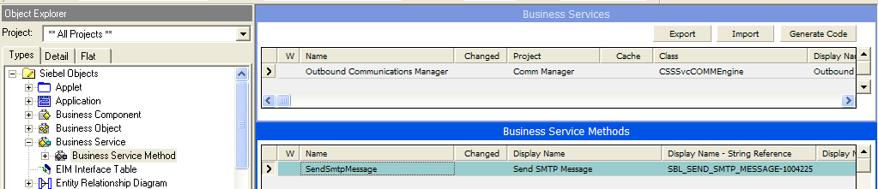
Business Services
A business service is a type of program that can be called within the Siebel application
  Encapsulates business logic
Business service types:
  Siebel Provided—these are shipped with the application
    Example: Outbound Communications Manager—allows you to send an email
  Custom—business services created by Siebel developers
    Example: custom code to verify a credit card
Notes:
Many Business Services appear in Siebel Tools. For a good example, use the Command Shell Processor business service, which contains Methods called About View and About Record.
These Siebel-provided business services are written in C++ by Siebel Engineering. Customers cannot change their source code, but instead use these business services to perform the tasks for which they were written.
Custom business services can be written by customers using the scripting languages described later in the module. Note that customers cannot write their own business services in C++.

Slide 15
Custom Scripts
Are procedures that enable configuration of Siebel applications to extend standard behavior
  Are triggered by Siebel Events
Are written in either
  Siebel Visual Basic
    Similar to Visual Basic for Applications (VBA)
    Used only on Windows platforms
  Siebel eScript
    Based on ECMAScript (Similar to JavaScript)
    Used on Windows and UNIX platforms
  JavaScript
    Used for browser scripting
Custom scripting should be considered a last resort when no other Siebel mechanisms will fulfill the business requirements
Notes:
There is a Web based title called “Declarative Alternatives to Siebel Scripting” that may help students understand when script should be used, and matches declarative alternatives to common requirements where scripting is not required.
Scripting can cause significant upgrade issues, because scripts may reference objects, functions, events or methods that are no longer supported in a new release.
Scripting can also cause significant performance issues. For example, if a script is run every time users change records in the Account business component, and a user tries to scroll through thousands of account records instead of querying, they may see a significant performance issue.

Slide 16
Summary
This module showed you how to:
  Describe Siebel object instances and events
  Explain Siebel Event Handling
  List the processes that can be triggered by events
Notes:
Review Question: What executes in response to an event?
Answer: An event handler.

